Slide 1

Bangladesh Army University Of Science And Technology
Department of Computer Science and Engineering
Comparative performance analysis of five ML techniques on classifying defects in steel sheets from images.
Supervisor:
Taher Muhammad Mahdee
Designation:
Associate. Professor,
Department of Computer Science & Engineering
Presented By:
Md Abir Hasan (170201063)
Mihir Roy (170201028)

Slide 2
Presentation Outlines
Introduction
Motivation
Description of Problem
Related Work
Intended Outcome
Method
Dataset and feature
Flow Chart
Step Analysis
Result Analysis
Conclusion
Future Work
References

Slide 3
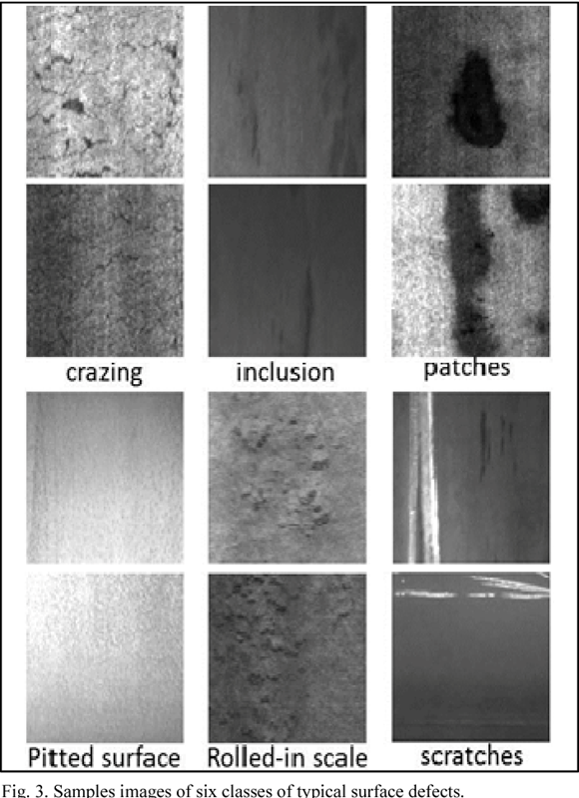
Introduction
What is a steel defect, and how does it occur?
Production process of flat steel
Heating and Rolling
Drying and Cutting
steel sheets need to undergo careful inspection
localizing and classifying surface defects
Fig 1: Defects

Slide 4
Motivation
This project is targeted to find efficiency and how much it can detect defects.
Main goal is to find good accuracy of detection.
Find an easy detection process for production / industry.
To produce a pure, defectless steel sheet.

Slide 5

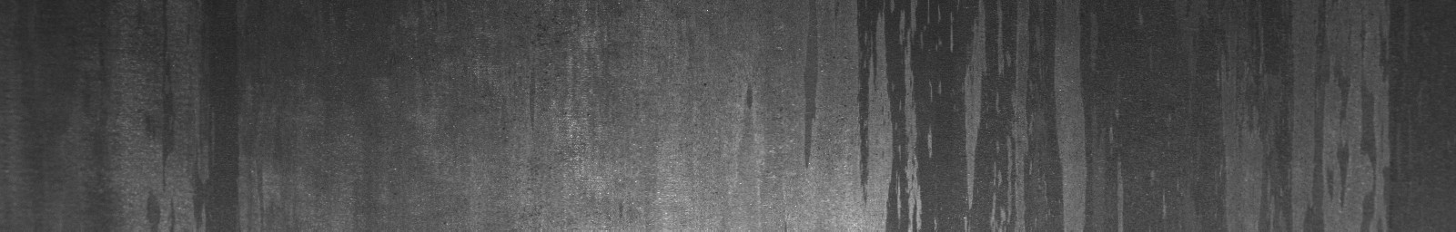
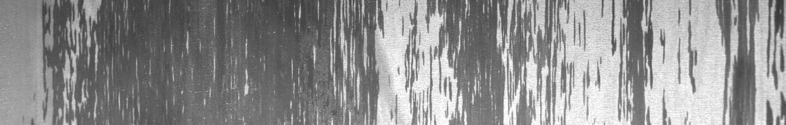
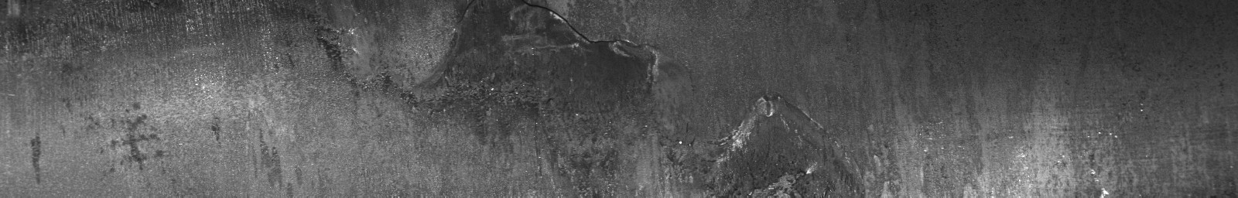
Description of Problem
Problem in production process.
Surface defect because of heating, rolling, drying, and cutting a steel sheet.
Defect 1
Defect 2
Defect 3
Defect 4

Slide 6
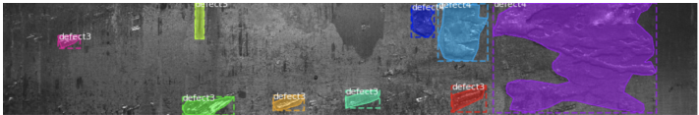
Related Work
Semantic Segmentation
CNN-Based Method (FCN)
Instance Segmentation
Proposal-Based Method (Mask R-CNN)
Segmentation-Based Method

Slide 7
Intended Outcome
To find efficient model for detect defect from image.
To achieve good accuracy of detection.
To learn how algorithms are working.

Slide 8
Method
We used these Deep and Machine learning methods for this thesis
Neural Network
CNN
Xception
Clustering
KNN
Classification
SVM
Random Forest

Slide 9
Dataset and feature
Dataset Collected from PAO Severstal (a vertically integrated steel and steel-related mining company, Russia)
Images provided are of size 1600 × 256 × 1 and total 12568 counts.
5902 images have defects, and 6666 images do not have defects.
We flatten all the images for the use of this project. So there are a large number of features.
We used 3100 data samples for this process.

Slide 10
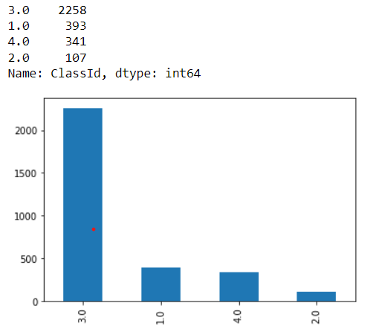
Dataset and feature
Datas are classified in 4 classes
for 4 types of steel defects.
Split Dataset
Training Data 80%
Test Data 20%
Fig 2: Data Classes

Slide 11
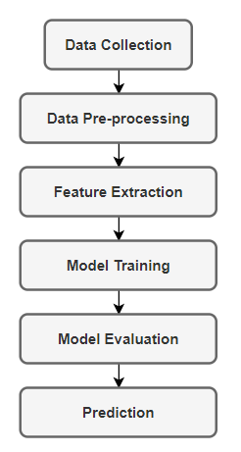
Flow Chart
Fig 3: A basic methodology diagram for steel defect detection

Slide 12
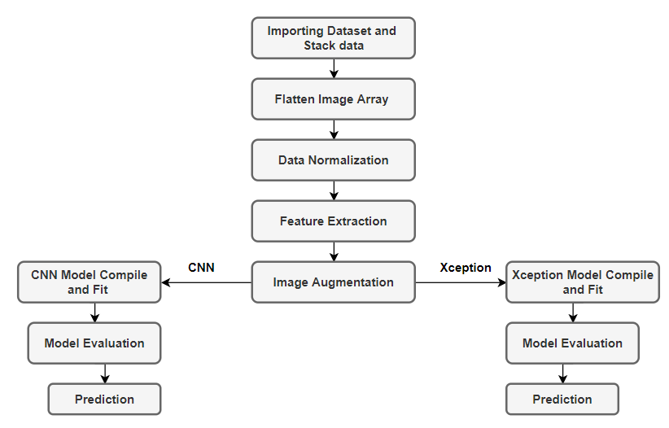
Flow Chart
Fig 4: Flow Chart For Neural Network

Slide 13
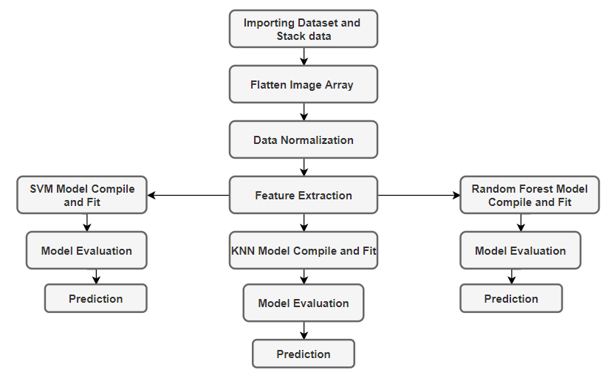
Flow Chart
Fig 5: Flow Chart For Classification and Clustering

Slide 14
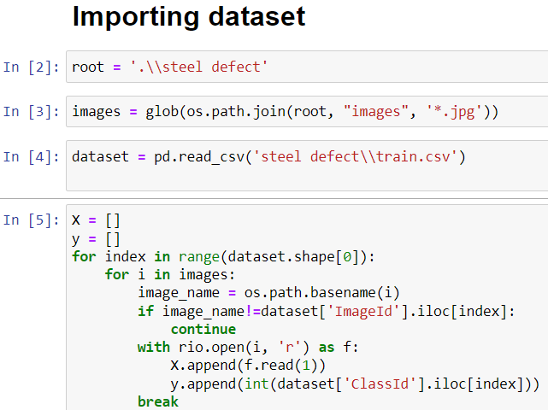
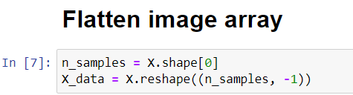
Step Analysis

Slide 15
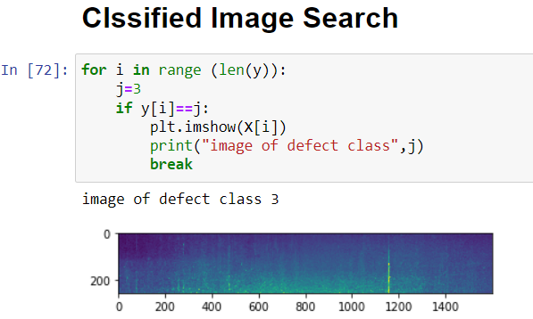
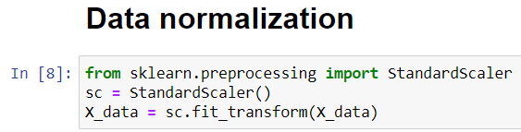
Step Analysis

Slide 16
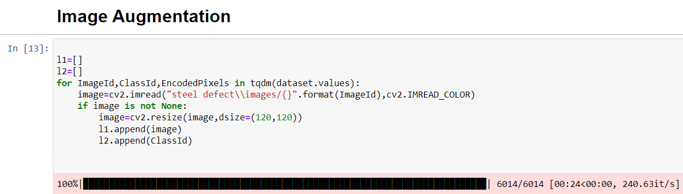
Step Analysis

Slide 17
Result Analysis
Accuracy Table:
No. | Model | Accuracy
1 | CNN | 75.81%
2 | Xception | 89.80%
3 | SVM | 75.80%
4 | Random Forest | 73.38%
5 | KNN (k=5) | 76.61%

Slide 18
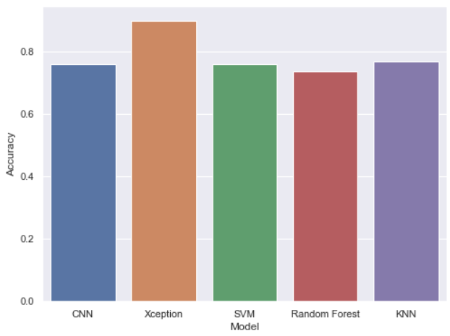
Result Analysis
Accuracy Bar Chart

Slide 19
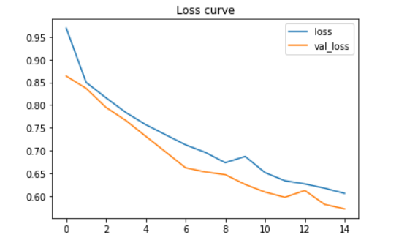
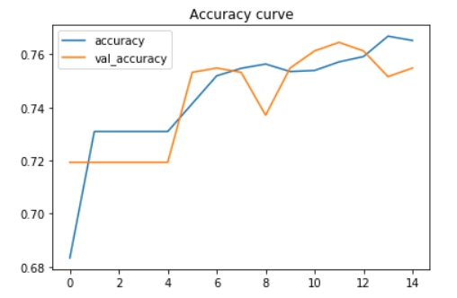
Result Analysis
CNN
Fig 6: Loss Curve
Fig 7: Accuracy Curve

Slide 20
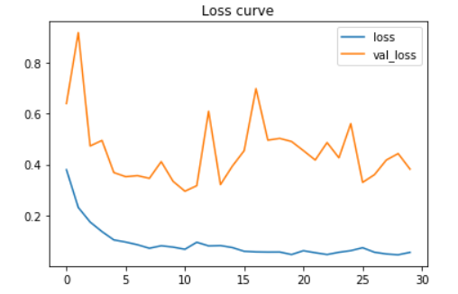
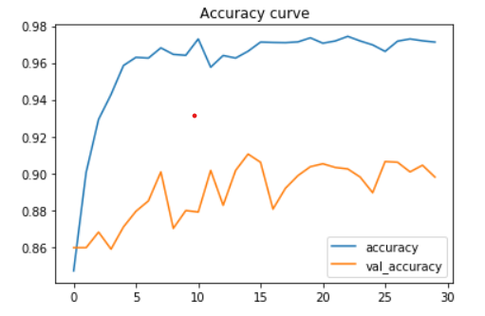
Result Analysis
Xception
Fig 8: Loss Curve
Fig 9: Accuracy Curve

Slide 21
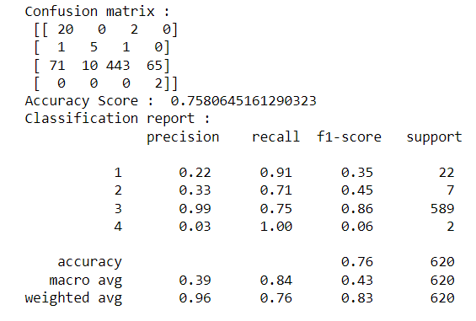
Result Analysis
SVM

Slide 22
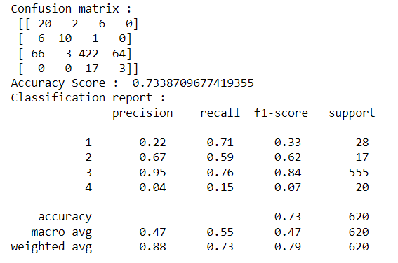
Result Analysis
Random Forest

Slide 23
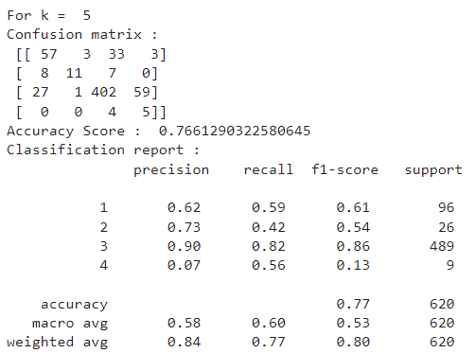
Result Analysis
KNN

Slide 24
Future Work
Due to the imbalance between different kinds of labels, more data augmentation processes such as rotation and scaling on the images should be performed on the rare defect classes.
Measure accuracy without reshaping the size of the image.
Measure accuracy with different sizes of images.
We can use multiple models in a single device to achieve more accurate results.

Slide 25
Conclusion
The model outputs the pixel-wise defected area with corresponding labels. Among all the models, I performed the task and compared their performance and achieved the highest accuracy of 89.80% for the Xception model.

Slide 26
References
J. Long, E. Shelhamer, and T. Darrell. Fully convolutional networks for semantic segmentation. In Proceedings of the IEEE conference on computer vision and pattern recognition, pages 3431–3440, 2015.
L.-C. Chen, G. Papandreou, I. Kokkinos, K. Murphy, and A. L. Yuille. Deeplab: Semantic image segmentation with deep convolutional nets, atrous convolution, and fully connected crfs. IEEE transactions on pattern analysis and machine intelligence, 40(4):834–848, 2017
H. Noh, S. Hong, and B. Han. Learning deconvolution network for semantic segmentation. In Proceedings of the IEEE international conference on computer vision, pages 1520– 1528, 2015
R. Girshick. Fast r-cnn. In Proceedings of the IEEE international conference on computer vision, pages 1440–1448, 2015
T.-Y. Lin, P. Dollar, R. Girshick, K. He, B. Hariharan, and ´ S. Belongie. Feature pyramid networks for object detection. In Proceedings of the IEEE conference on computer vision and pattern recognition, pages 2117–2125, 2017

Slide 27
References
T.-Y. Lin, M. Maire, S. Belongie, J. Hays, P. Perona, D. Ramanan, P. Dollar, and C. L. Zitnick. Microsoft coco: Common objects in context. In European conference on computer vision, pages 740–755. Springer, 2014.
M. Cordts, M. Omran, S. Ramos, T. Rehfeld, M. Enzweiler, R. Benenson, U. Franke, S. Roth, and B. Schiele. The cityscapes dataset for semantic urban scene understanding. In Proceedings of the IEEE conference on computer vision and pattern recognition, pages 3213–3223, 2016.
Z. Zhang, A. G. Schwing, S. Fidler, and R. Urtasun. Monocular object instance segmentation and depth ordering with cnns. In Proceedings of the IEEE International Conference on Computer Vision, pages 2614–2622, 2015
Z. Zhang, S. Fidler, and R. Urtasun. Instance-level segmentation for autonomous driving with deep densely connected mrfs. In Proceedings of the IEEE Conference on Computer Vision and Pattern Recognition, pages 669–677, 2016.
B. Romera-Paredes and P. H. S. Torr. Recurrent instance segmentation. In European conference on computer vision, pages 312–329. Springer, 2016.

Slide 28
References
L. Shen, Z. Lin, and Q. Huang. Relay backpropagation for effective learning of deep convolutional neural networks. In European conference on computer vision, pages 467–482. Springer, 2016.
Severstal: Steel Defect Detection
F. Chollet. Xception: Deep learning with depth wise separable convolutions. In Proceedings of the IEEE conference on computer vision and pattern recognition, pages 1251–1258, 2017.
Weidong Zhao, Feng Chen, Hancheng Huang, Dan Li, Wei Cheng, "A New Steel Defect Detection Algorithm Based on Deep Learning", Computational Intelligence and Neuroscience, vol. 2021, Article ID 5592878, 13 pages, 2021.
Qianlai Sun (孙前来), Yin Wang (王银) and Zhiyi Sun (孙志毅),” Rapid surface defect detection based on singular value decomposition using steel strips as an example” AIP Advances 8, 055209 (2018).

Slide 29
References
Kun Qian, “Automated Detection of Steel Defects via Machine Learning based on Real-Time Semantic Segmentation” ICVIP 2019: Proceedings of the 3rd International Conference on Video and Image Processing, Pages 42–46, December 2019.
Matthew Browne, Saeed Shiry Ghidary, “Convolutional Neural Networks for Image Processing: An Application in Robot Vision” Australasian Joint Conference on Artificial Intelligence AI 2003: Advances in Artificial Intelligence pp 641-652.
Zhu Fan, Jia-Kun Xie, Zhong-yu Wang, Pei-Chen Liu, “ Image Classification Method Based on Improved KNN Algorithm” J. Phys.: Conf. Ser. 1930, 2021 International Conference on Sensing Technology and Applications (ICSTA 2021) 23-25 April 202
Baoxun Xu, Yunming Ye, Lei Nie, “An improved random forest classifier for image classification” In proceeding of the 2012 IEEE International Conference on Information and Automation, 6-8 June 2012.

Slide 30
Thank You

